Slide 1
Arithmetic
Pipelining
Hwang and Briggs

Slide 2
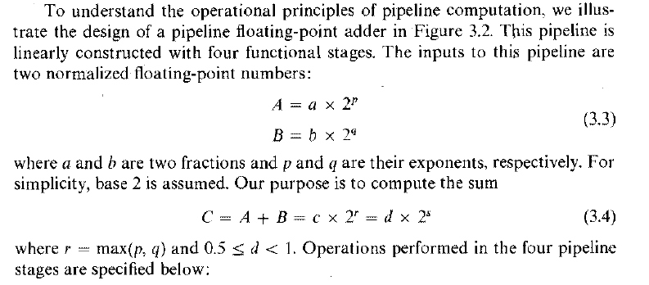
Pipeline Fraction Adder or Floating Point Adder

Slide 3
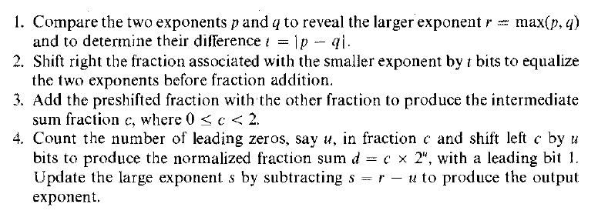
Operations performed in 4 pipelined stages are:

Slide 4
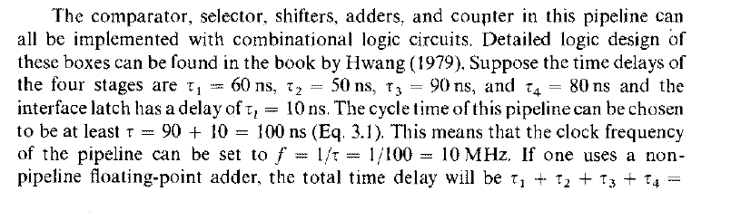
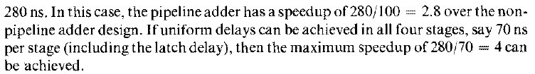
Time Delays per Stage Speedup

Slide 5
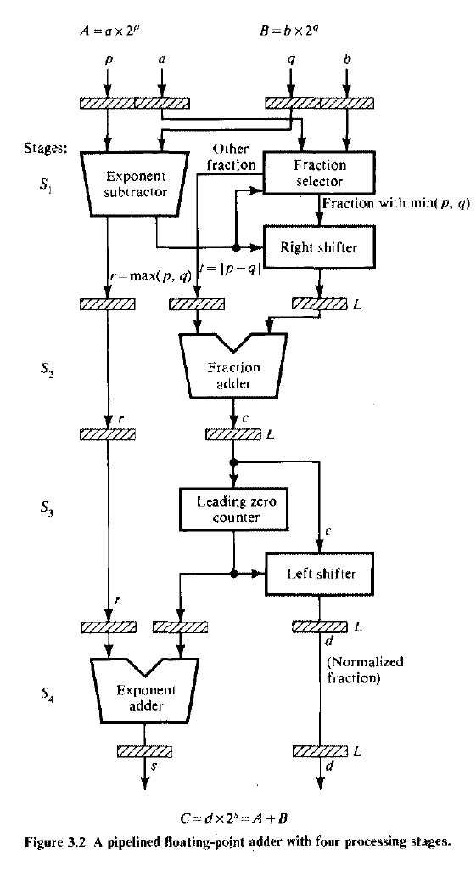

Slide 6
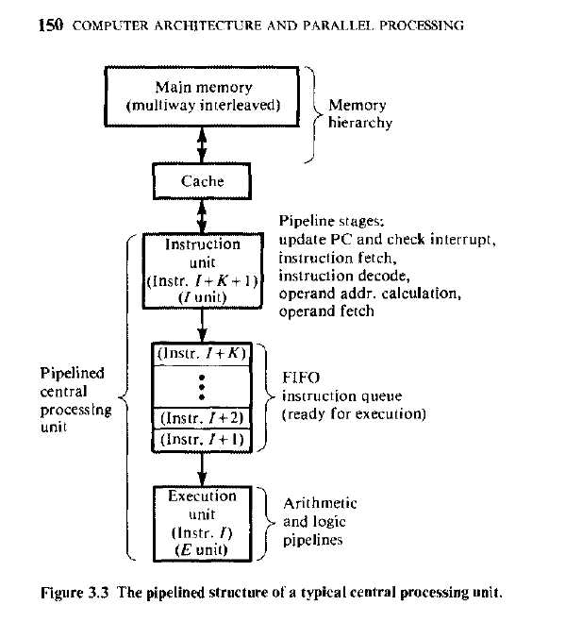

Slide 7
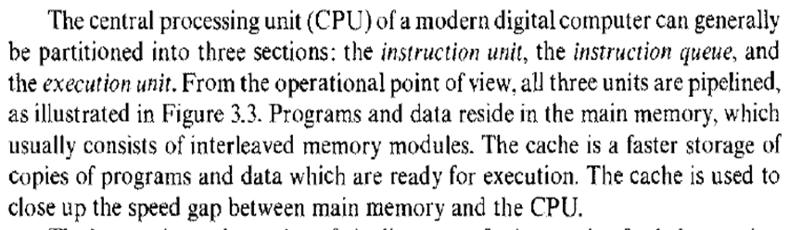
Description about the figure in previous slide

Slide 8
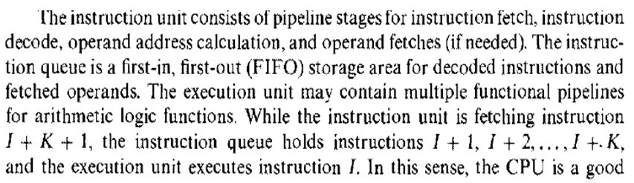
Description about the figure
Continued from previous slide

Slide 9
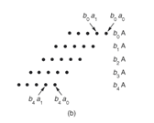
Pipeline Multiplier using Carry Save Adder(CSA)
  The 5-bit number in A is multiplied by b₄b₃b₂b₁b₀
(b) shows the inputs to the adders to do partial summation in regular multiplication

Slide 10
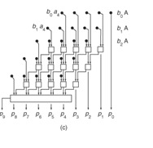
Pipeline Multiplier using Carry Save Adder(CSA) contd…..
Showing all the full adders. 3 inputs taken by full adders and 2 outputs given (reduces carry propagation delay in every stage of partial addition).Last stage is a carry-look-ahead adder(/CPA)( 5 bit numbers being added at each stage with 5 full adders-as in previous slide of Array Multiplication)

Slide 11
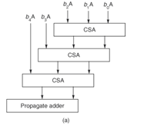
Pipeline Multiplier using Carry Save Adder(CSA) contd….
An array multiplier. The 5-bit number in A is multiplied by b₄b₃b₂b₁b₀. (a) shows the block diagram of the previous slide.

Slide 12
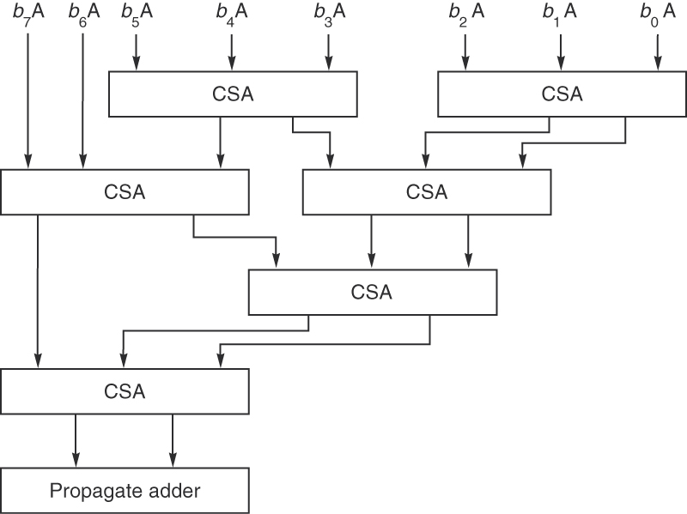
Wallace Tree for multiplying 2 numbers of 8 bits each
Figure J.30 Wallace tree multiplier for multiplying 8bit , 2 numbers A and B.
An example of a multiply tree that computes a product in 0(log n) steps.
Practice Problem: Draw Wallace Tree for multiplying i) 5 bit numbers.
ii) 6 bit numbers iii) 7 bit numbers
Copyright © 2011, Elsevier Inc. All rights Reserved.

Slide 13
In Wallace tree architecture
  all the bits of all of the partial products in each column are added together by a set of counters in parallel without propagating any carries.
Another set of counters then reduces this new matrix and so on, until a two-row matrix is generated.
  counter used is the 3:2 counter which is a Full Adder..
The final results are added using usually carry propagate adder.
The advantage of Wallace tree is speed because the addition of partial products is now O (logN).

Slide 14
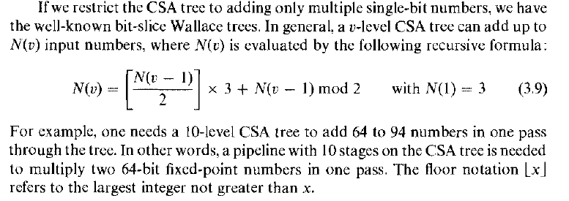

Slide 15
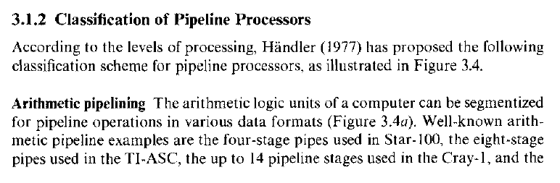

Slide 16
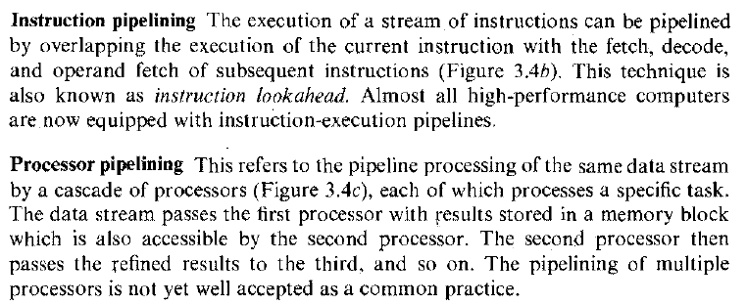

Slide 17
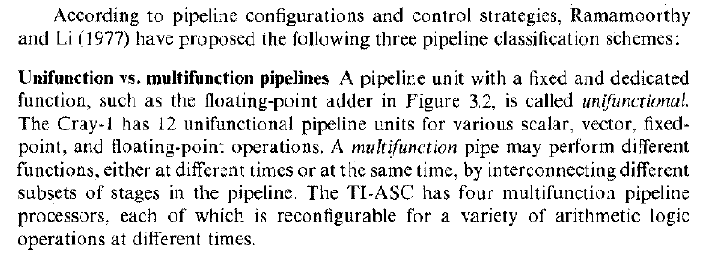

Slide 18
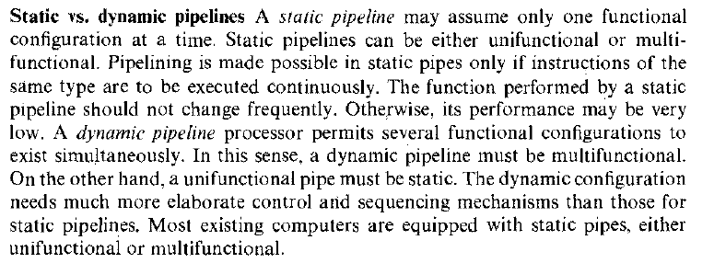

Slide 19
